Slide 1
المحاضرة الثامنة

Slide 2
Why do we use them
□ We use transforms to transform the problem into a one that is easier to solve then use the inverse transform to obtain the solution to the original problem
Definition of Laplace Transform
∞
F (s) = L{ f (t)} = ∫ f (t)e^{−st}dt
₀−

Slide 3
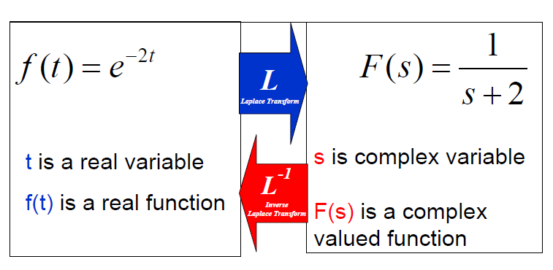
Laplace Transform
Time Domain
Frequency Domain

Slide 4
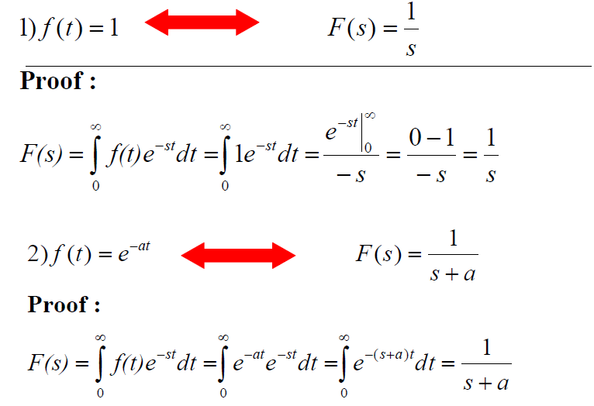

Slide 5
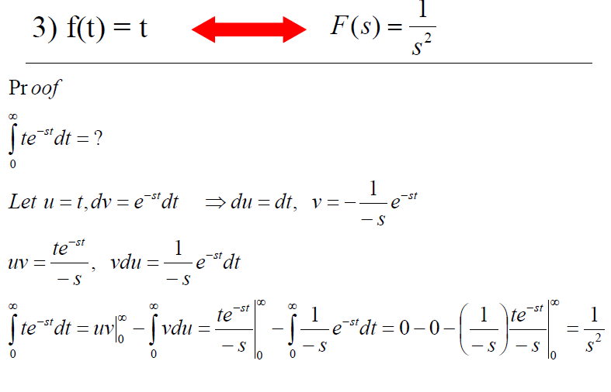

Slide 7
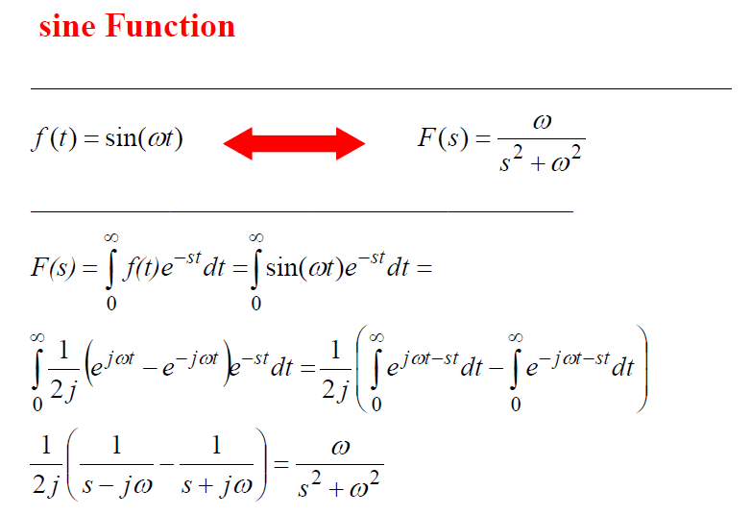

Slide 8
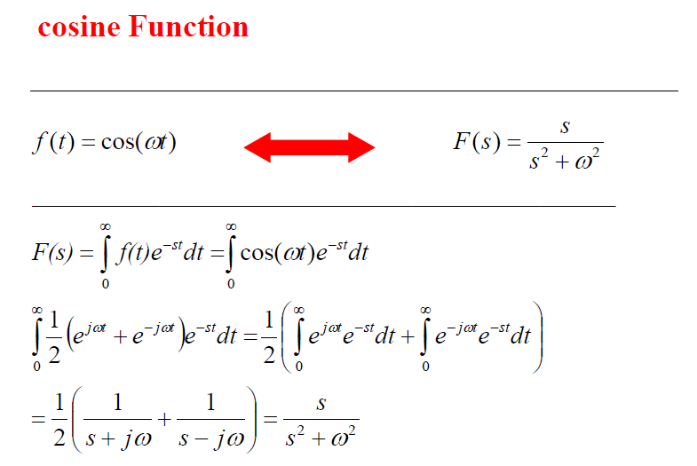

Slide 9
